Slide 1
Network Architectures
Chapter 7

Slide 2
Learning Objectives
Understand different major network architectures, including Ethernet, token ring, AppleTalk, ARCnet, FDDI, and ATM
Understand standards governing network architectures
Understand limitations, advantages, and disadvantages of each standard or architecture

Slide 3
Ethernet
Many experiments in early 1960s and 1970s to connect several computers and share data
ALOHA network at University of Hawaii
Early version of Ethernet developed at Xerox’s Palo Alto Research Center in 1972
DIX (Digital, Intel, Xerox) developed standard that transferred at 10 Mbps
IEEE used it as basis for 802.3 specification

Slide 4
Overview of Ethernet
Popular network architecture with many advantages:
Ease of installation
Low cost
Support for different media
Features include packing data into frames, using CSMA/CD channel access, and using hardware (MAC) address
Divided into three categories based on transmission, speed, and media

Slide 5
10 Mbps IEEE Standards
Four major implementations:
10Base5 – using thick coaxial cable
10Base2 – using thinnet coaxial cable
10BaseT – using unshielded twisted-pair (UTP) cable
10BaseF – using fiber-optic cable

Slide 6
10Base5
Uses transceivers attached to thicknet by vampire tap
Drop cable connects transceiver to NIC’s AUI or DIX port
Stringent distance limitations
Figure 7-1 shows 10Base5 network

Slide 7
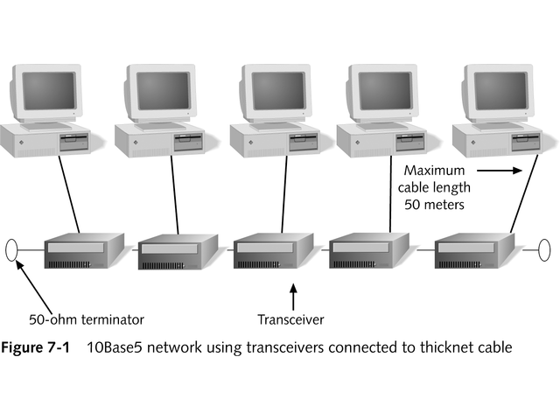
10Base5 Network

Slide 8
10Base5
All coaxial Ethernet follow 5-4-3 end-to-end rule to prevent attenuation
Maximum of five segments
Four repeaters
Devices attached to three segments
See Figure 7-2
Rule applies only to individual segments
Figure 7-3 shows larger network with numerous segments and repeaters
Table 7-1 summarizes 10Base5 Ethernet

Slide 9
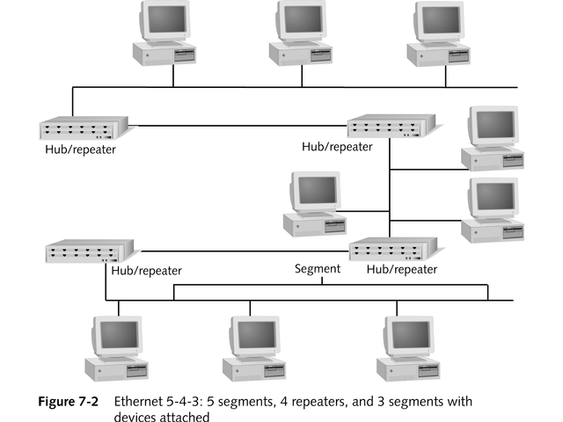
Ethernet 5-4-3 Segments

Slide 10
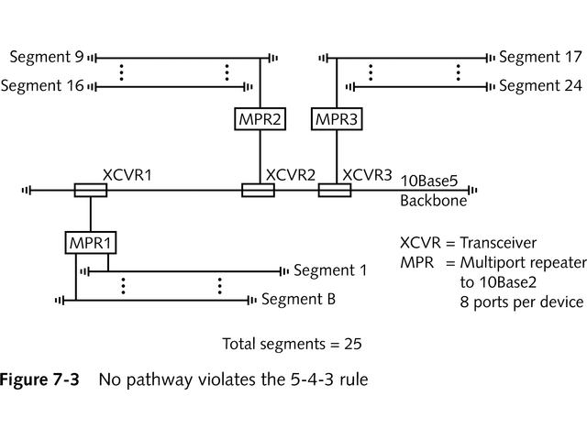
No Pathway Violates 5-4-3 Rule

Slide 11
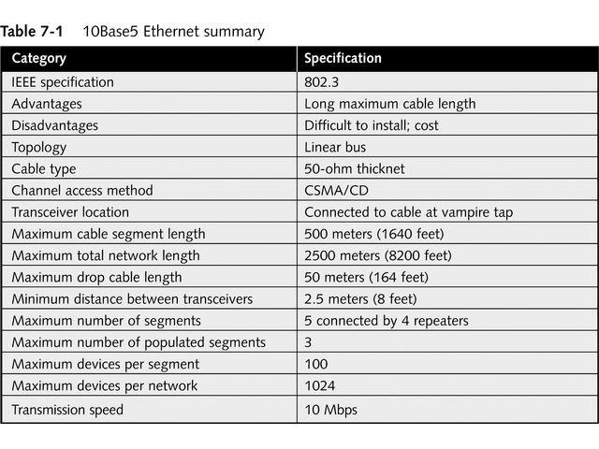
10Base5 Ethernet Summary

Slide 12
10Base2
Originally supported 200-meter cable segment, but shortened to 185 meters to improve performance and allow for patch cables
Uses more flexible thinnet coaxial cable with 50 ohm cable
Follows 5-4-3 rule
Barrel connector joins two shorter thinnet cables
Supports up to 30 devices per cable segment
Easy to install, cheaper, but now rarely used
Table 7-2 summarizes 10Base2 standard

Slide 13
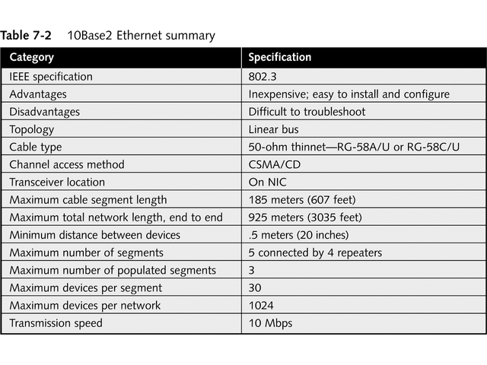
10Base2 Ethernet Summary

Slide 14
10BaseT
Uses Category 3, 4, or 5 unshielded twisted-pair (UTP) cable
Low cost makes it most popular Ethernet network
Wired as star topology but uses bus signaling system internally, as shown in Figure 7-4
No more than five cabling segments, no more than four hubs between communicating workstations
Up to 1024 computers

Slide 15
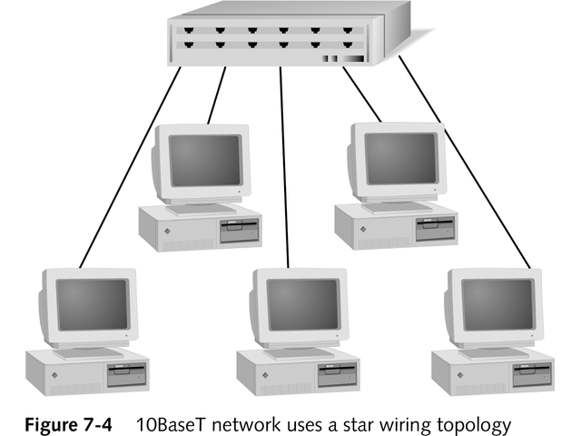
10BaseT Network Uses Star Topology

Slide 16
10BaseT
100 meter maximum cable segment length
Extend length by connecting hubs with 10Base2 or 10Base 5 cable, as seen in Figure 7-5
Table 7-3 summarizes 10BaseT Ethernet

Slide 17
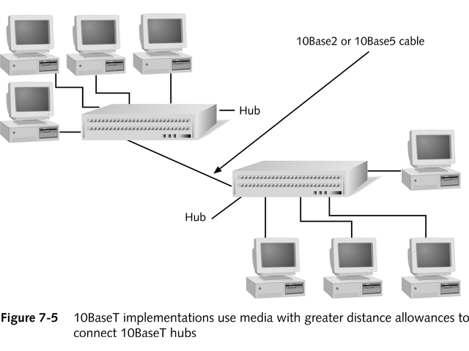
10BaseT with Coaxial Cable Connecting Hubs

Slide 18
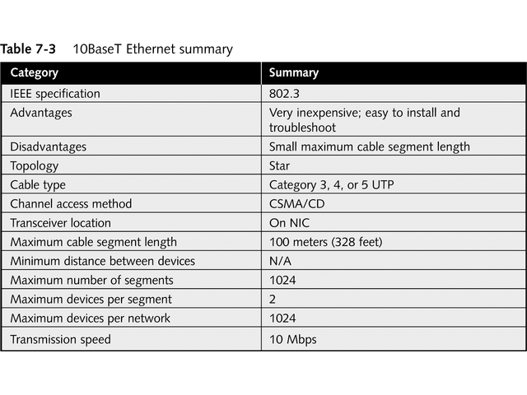
10BaseT Ethernet Summary

Slide 19
10BaseF
Uses fiber-optic cable
Three subcategories
10BaseFL – links computers in LAN environment
10BaseFP – links computers using passive hubs; maximum cable segment length of 500 meters
10BaseFB – uses fiber-optic cable as backbone between hubs
Usually wired as a star with maximum of 1024 nodes connected by repeaters
Table 7-4 summarizes 10BaseF Ethernet

Slide 20
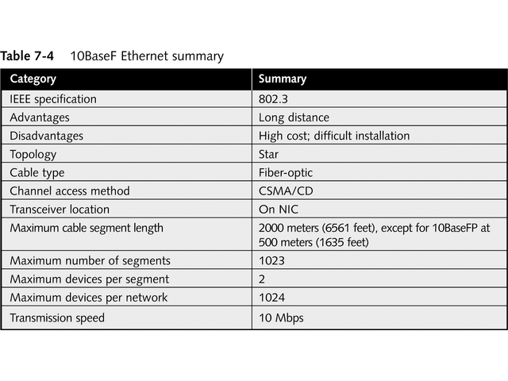
10BaseF Ethernet Summary

Slide 21
100 Mbps IEEE Standards
Two most popular 100 Mbps Ethernet standards are:
100 VG-AnyLAN
100BaseT, also called Fast Ethernet

Slide 22
100VG-AnyLAN
Developed by Hewlett-Packard and AT&T
Combines Ethernet and token ring architecture
Uses demand priority channel access method
Intelligent hubs control network communications
Hubs can cascade from root or parent hub, as shown in Figure 7-6
Can use UTP Category 3 or higher cable
Biggest limitation is cost
Table 7-5 summarizes 100VG-AnyLAN

Slide 23
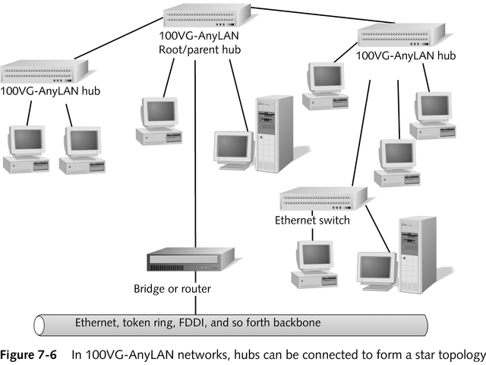
Hubs Form Star Topology

Slide 24
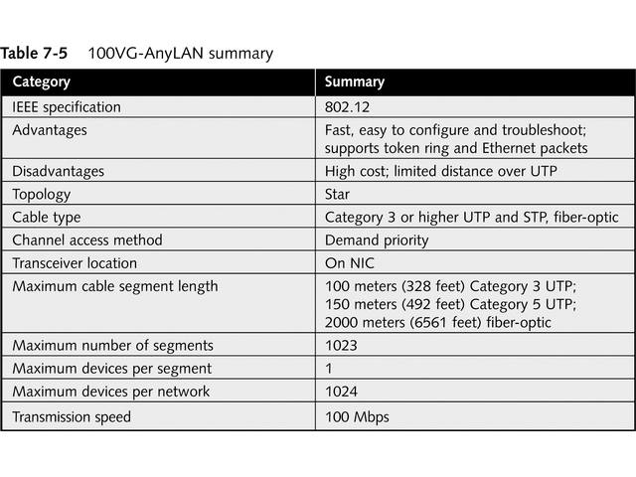
Summary of 100 VG-AnyLAN

Slide 25
100BaseT
Current IEEE standard is 802.3u
Three substandards define cable type:
100BaseT4 – four-pair Category 3, 4, or 5 UTP
100BaseTX – two-pair Category 5 UTP
100BaseFX – two-strand fiber-optic cable

Slide 26
100BaseT
Two types of 100BaseT hubs:
Class I – may have only one between communicating devices
Class II – may have maximum of two between devices
Figure 7-7 shows switches interconnecting multiple hubs
Table 7-6 summarizes 100BaseT Ethernet

Slide 27
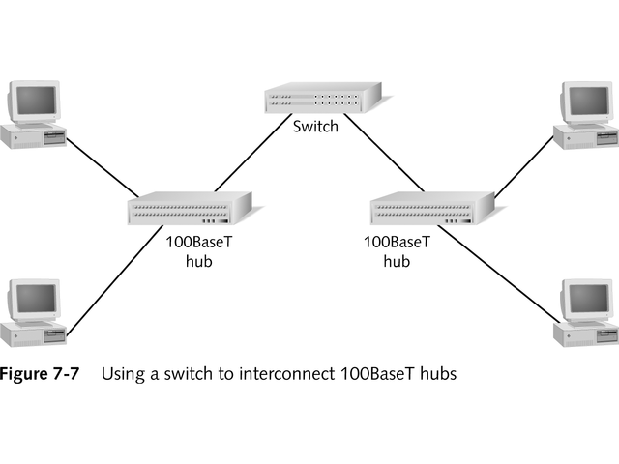
Switch Interconnects 100BaseT Hubs

Slide 28
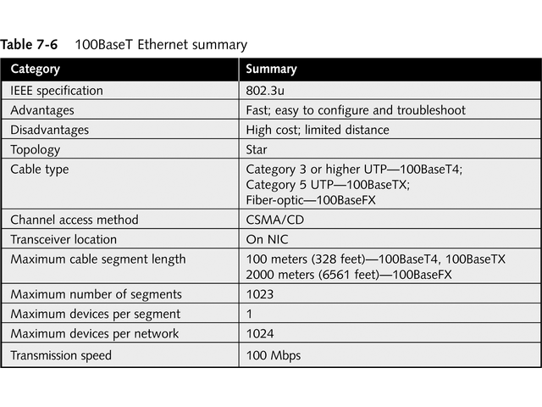
Summary of 100BaseT Ethernet

Slide 29
Gigabit Ethernet: 1 Gbps IEEE 802.3z Standards
1000BaseX identifies various Gigabit Ethernet standards
Requires different signaling methods
Uses 8B/10B coding scheme with 8 bits of data and 2 bits of error-correction data
Most use full-duplex mode

Slide 30
Gigabit Ethernet: 1 Gbps IEEE 802.3z Standards
Two separate extensions cover 1000BaseX and 1000BaseT
802.3z-1998 – covers 1000BaseX including
L – long-wave-length laser/fiber-optic
S – short wavelength laser/fiber-optic
C – copper jumper cables
802.3ab-1999 – covers1000BaseT requiring four pairs of 100-ohm Category 5 cable or better

Slide 31
1000BaseLX
Uses fiber-optic media
Long wavelengths between 1270 and 1355 nanometers with single mode and multimode
Standard specifies maximum cable length of 5000 meters, but special transceivers extend that length
Table 7-7 summarizes 1000BaseLX Ethernet

Slide 32
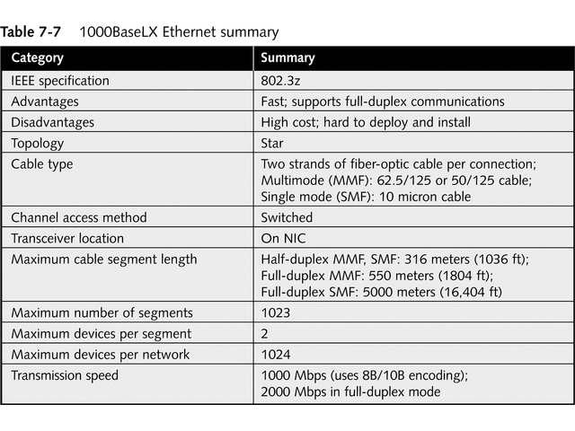
Summary of 1000BaseLX Ethernet

Slide 33
1000BaseSX
Uses fiber-optic media
Short wavelengths between 770 and 860 nanometers with multimode
Table 7-8 summarizes 1000BaseSX Ethernet

Slide 34
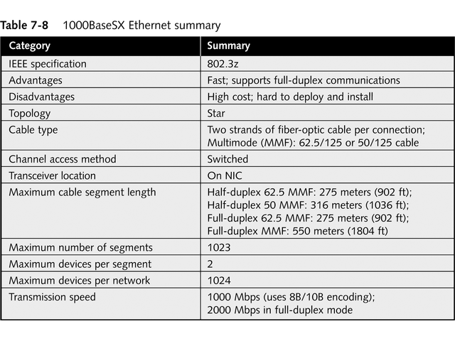
Summary of 1000BaseSX Ethernet

Slide 35
1000BaseCX
Uses specially shielded copper jumper cables
Limited to 25 meters
Used primarily in wiring closets or equipment racks
Table 7-9 summarizes 1000BaseCX Ethernet

Slide 36
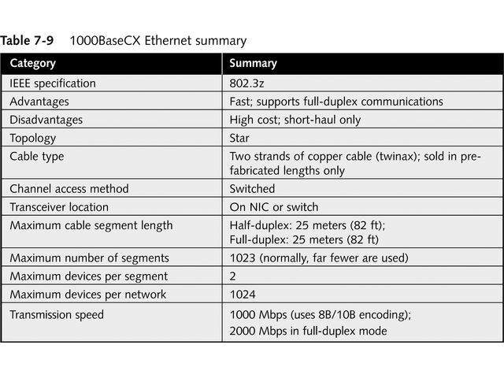
Summary of 1000BaseCX Ethernet

Slide 37
1000BaseT
IEEE Standard 802.3ab
Uses 100-meter segments of balanced Category 5 copper cable
Transmits 250 Mbps over each of four required pairs of wires
Supports full-duplex by using special equipment called hybrids and cancellers
Uses same two signal methods as 100 Mbps Ethernet
Table 7-10 summarizes 1000BaseT Ethernet

Slide 38
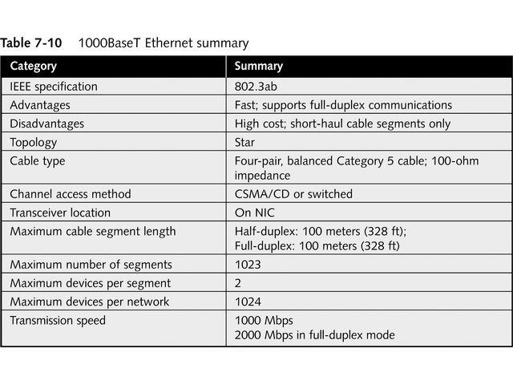
Summary of 1000BaseT Ethernet

Slide 39
10 Gigabit Ethernet: 10 Gbps IEEE 802.3ae Standard
Anticipated ratification in late 2002
Runs only on fiber-optic cabling, using both single-mode and multi-mode
Maximum length is 5 km
Uses full-duplex
Likely to be used as network backbone and in Storage Area Networks (SANs)
Able to scale from 10 Mbps to 10 Gbps speeds

Slide 40
Ethernet Frame Types
Four unique Ethernet frame types
Ethernet 802.3 used by IPX/SPX on Novell NetWare 2.x or 3.x networks
Ethernet 802.2 used by IPX/SPX on Novell 3.12 and 4.x networks; default with Microsoft NWLink
Ethernet SNAP used with EtherTalk and mainframes
Ethernet II used by TCP/IP
Types must match for two devices to communicate
Packet size ranges from 64 to 1518 bytes

Slide 41
Ethernet 802.3
Also called Ethernet raw
Does not completely comply with 802.3 specifications
Used with Novell NetWare 2.x or 3.x
Figure 7-8 shows frame

Slide 42
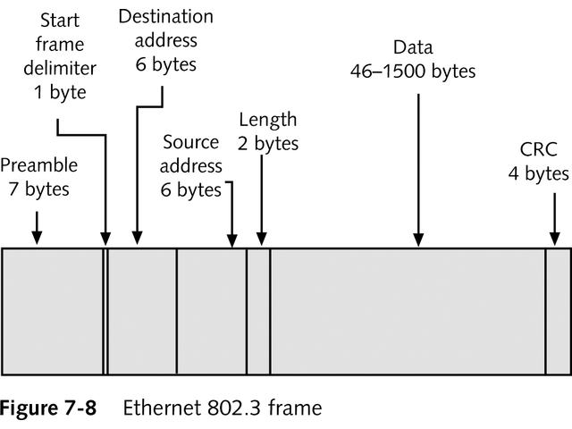
Ethernet 802.3 frame

Slide 43
Ethernet 802.2
Completely complies with 802.3 standard
Fields are similar to those of 802.3
Has three additional Logical Link Control (LLC) fields

Slide 44
Ethernet SNAP
SubNetwork Address Protocol
Used by AppleTalk
Includes protocol type field with identification of network protocol

Slide 45
Ethernet II
Used by TCP/IP networks
Differs slightly from 802.3 frames
Uses Type field instead of length field
See Figure 7-9

Slide 46
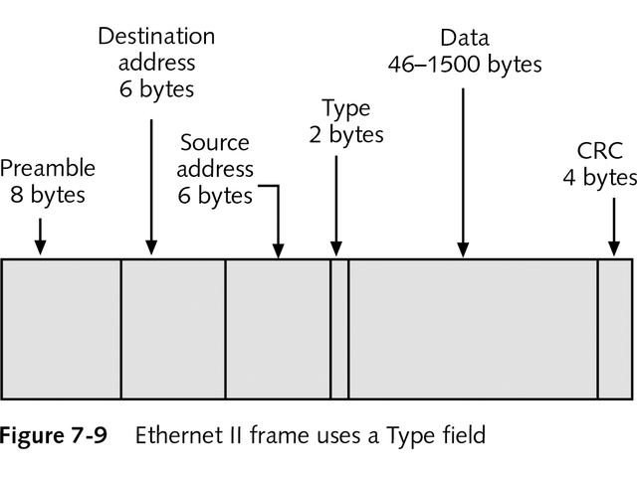
Ethernet II Frame

Slide 47
Segmentation
Breaking network down into manageable pieces
Uses switch or router between network segments
Allows for more efficient network traffic
See Figure 7-10

Slide 48
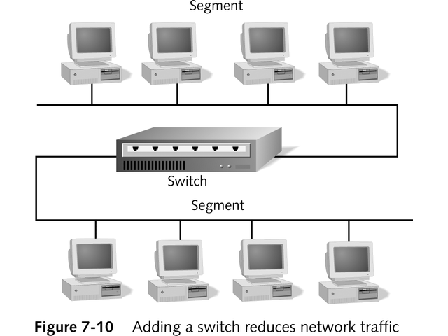
Switch Segments Network

Slide 49
Wireless Ethernet: IEEE 802.11b
Uses wireless access point (WAP) as center of star network
Workstations have wireless NICs
CSMA/CA access method with acknowledgement for every packet
Handshaking before transmission prevents hidden node problem
Standard specifies transmission rate of 11 Mbps
No fixed segment lengths, but maximum distance usually 300 feet with no obstructions

Slide 50
Token Ring
Developed by IBM
Provides fast reliable transport using twisted-pair cable
Wired in physical star topology
Functions as logical ring
See Figure 7-11

Slide 51
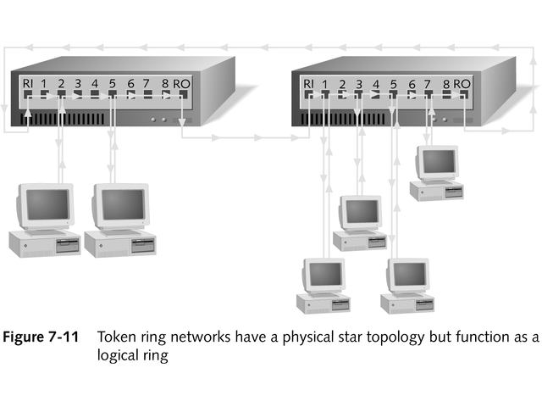
Token Ring: Physical Star Functions as Logical Ring

Slide 52
Token Ring Function
Uses token-passing channel access method
Receives token from Nearest Active Upstream Neighbor (NAUN)
Passes token to Nearest Active Downstream Neighbor (NADN)
Provides equal access to all computers
Uses larger packets, between 4000 and 17,800 bytes with no collisions
Originally operated at 4 Mbps, but newer version increased speed to 16 Mbps

Slide 53
Beaconing
Technique automatically isolates faults
First computer powered on network becomes active monitor managing beaconing process
Other computers are standby monitors
Active computer sends special packet to nearest downstream neighbor every 7 seconds
Packet announces address of active monitor
Network is intact if packet travels around network and returns to active monitor
Figure 17-12 shows ability to reconfigure network to avoid problem area

Slide 54
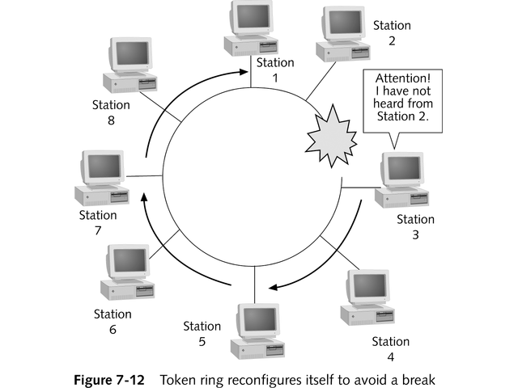
Token Ring Reconfiguration to Avoid Break

Slide 55
Hardware Components
Uses Multistation Access Unit (MAU or MSAU) or Smart Multistation Access Unit (SMAU)
Two ports connect hubs in a ring
Ring Out (RO) port on one hub connects to Ring In (RI) port on next hub to form ring
IBM’s implementation allows connection of 33 hubs
Originally maximum of 260 stations per network; now doubled to 520 maximum

Slide 56
Cabling in a Token Ring Environment
IBM defined cable types
Based on American Wire Gauge (AWG) standard that specified wire diameters
See Table 7-11
Table 7-12 summarizes token ring

Slide 57
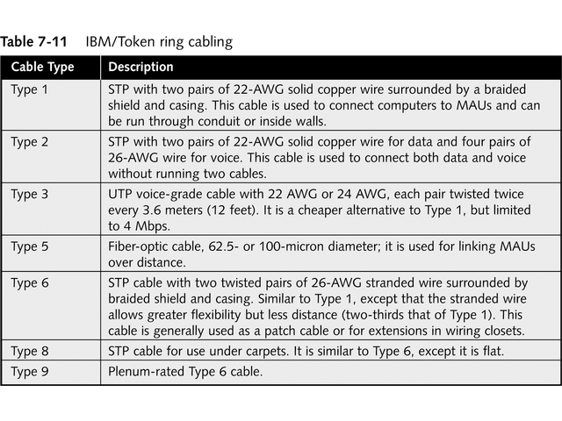
IBM/Token Ring Cabling

Slide 58
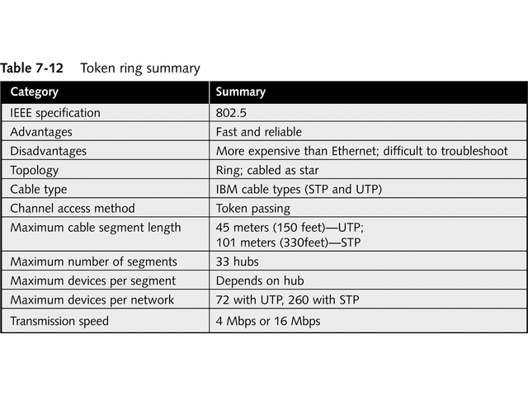
Summary of Token Ring

Slide 59
AppleTalk and ARCnet
Designed by Apple Computers, Inc., for Macintosh networks
ARCnet rarely used today
LocalTalk is physical implementation of AppleTalk

Slide 60
AppleTalk Environment
Simple, easy-to-implement network architecture
Uses built-in network interface on Macintoshes
AppleTalk refers to overall network architecture, while LocalTalk refers to cabling system
Uses dynamic addressing scheme
Computer chooses numeric address and broadcasts it to make sure it is unused

Slide 61
AppleTalk Environment
Phase 1 supported only 32 computers per network but was later increased to 254 computers and devices
Phase 2 introduced EtherTalk and TokenTalk
Allowed AppleTalk protocols to operate over Ethernet and token ring networks, respectively
Increased maximum computers on AppleTalk network to more than 16 million

Slide 62
LocalTalk
Uses STP in bus topology
Connector consists of three connectors: one to computer and two that join devices, as seen in Figure 7-13
LocalTalk network resembles tree, as seen in Figure 7-14
Uses CSMA/CA channel access method
Maximum transmission speed is only 230.4 Kbps

Slide 63
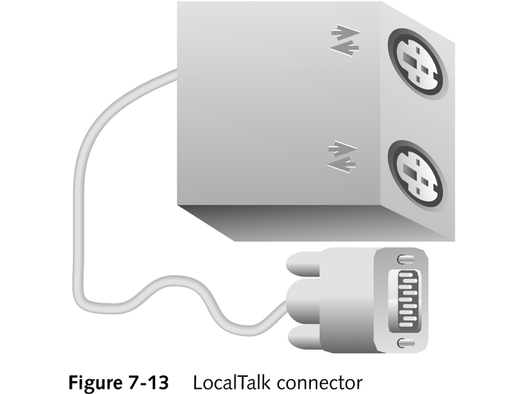
LocalTalk Connector

Slide 64
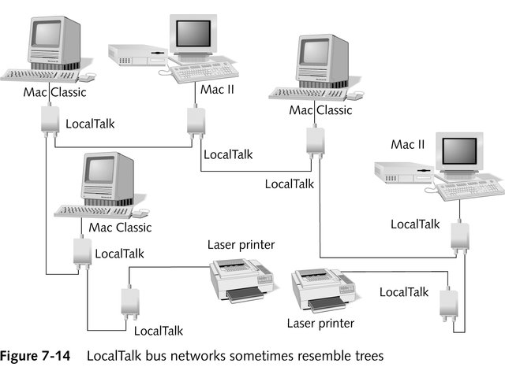
LocalTalk Bus Networks Resemble Tree

Slide 65
EtherTalk and TokenTalk
EtherTalk runs over 10 Mbps IEEE 802.3 network
Both supports AppleTalk Phase 2 and extended addressing
Table 7-13 summaries LocalTalk standard

Slide 66
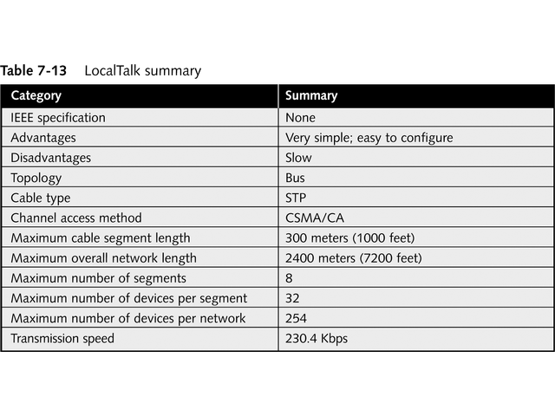
Summary of LocalTalk

Slide 67
ARCnet Environment
Attached Resource Computer Network (ARCnet) introduced by Datapoint Corporation
Uses token-passing channel access method
Transmits up to 2.5 Mbps
Wired like bus or star, but operates in virtual token ring, as seen in Figure 7-15
Can use UPT, coaxial, or fiber-optic cable

Slide 68
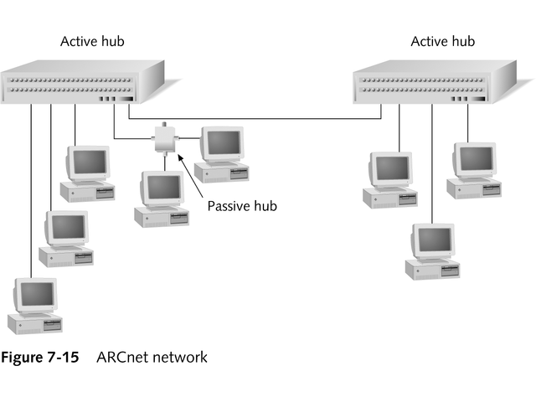
ARCnet Network

Slide 69
ARCnet Environment
Token passes between computers based on station identifiers (SIDs)
Use bank of DIP switches to set SID for each computer
SID ranges from 1-255
Last computer must have SID 255
It returns token to SID 1, as seen in Figure 7-16

Slide 70
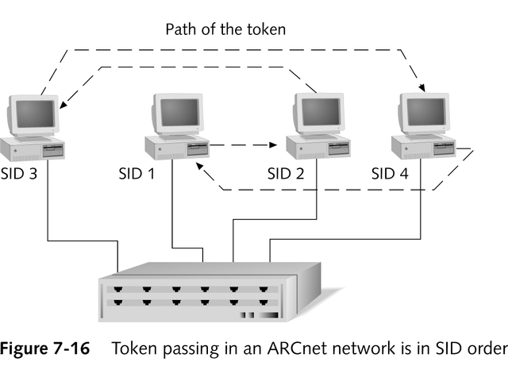
ARCnet Network Passes Token in SID Order

Slide 71
ARCnet Environment
Several disadvantages, including
Decreased network efficiency due to token passing based on SID
Manual configuration of SID numbers and possibility of duplicate addresses
Low speed; limited to 2.5 Mbps, but new version ARCnetPlus transmits up to 20 Mbps
Inability to connect with other network architectures
Table 7-14 summaries ARCnet

Slide 72
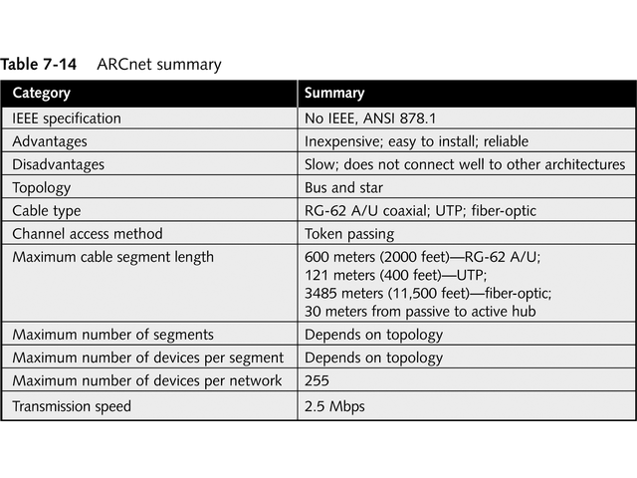
Summary of ARCnet

Slide 73
FDDI
Fiber Distributed Data Interface
Uses token-passing channel access method
Features dual counter-rotating rings for redundancy, as seen in Figure 7-17
Transmits at 100 Mbps
Includes up to 500 nodes over distance of 100 km (60 miles)
Wired as physical ring, uses no hubs
Can use concentrators as central connection point

Slide 74
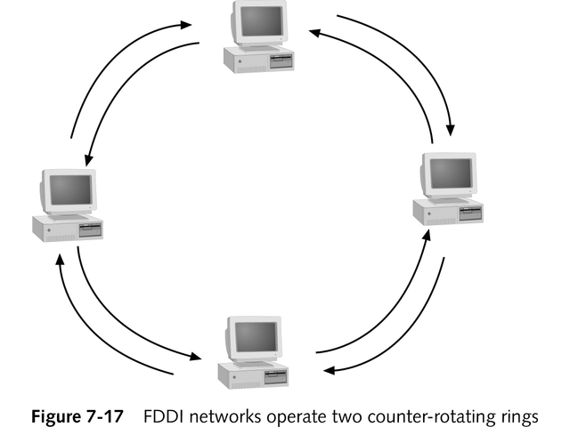
FDDI Network with Counter-Rotating Rings

Slide 75
FDDI
Computer with token can send more than one data frame
Avoids collisions by calculating network latency
Can assign priority level to particular station or type of data
Dual counter-rotating rings
Data travels on primary ring
In case of break, data moves to secondary ring, as shown in Figure 7-18

Slide 76
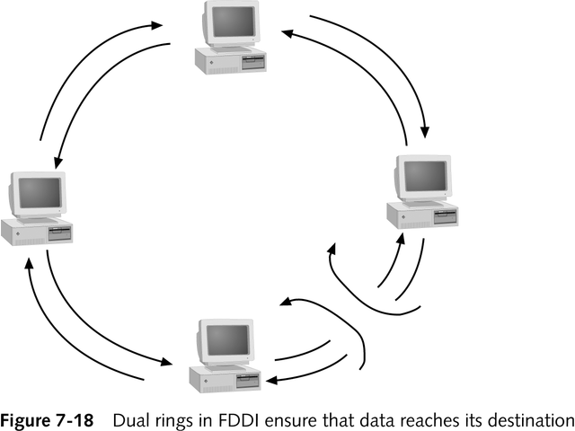
Dual Rings in FDDI Ensures Data Reaches Destination

Slide 77
FDDI
Uses two types of NICs
Dual Attachment Stations (DAS) – attaches to both rings; used for servers and concentrators
Single Attachment Stations (SAS) – connects to only one ring; used for workstations attached to concentrators
Table 7-15 summarizes FDDI architecture

Slide 78
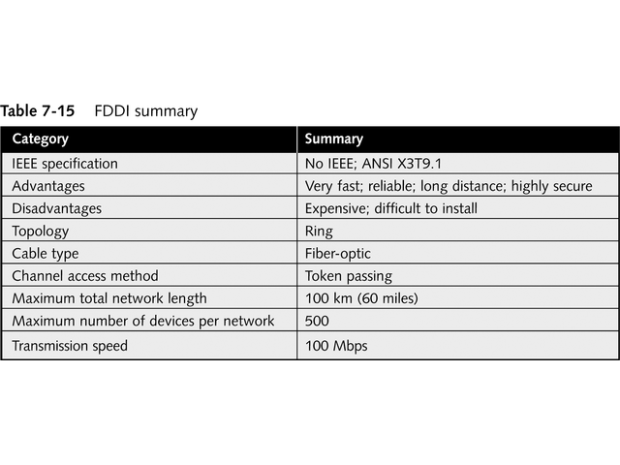
Summary of FDDI

Slide 79
Other Networking Alternatives
Many broadband technologies, including
Cable modem
Digital Subscriber Line (DSL)
Broadcast technologies
Asynchronous Transfer Mode (ATM)

Slide 80
Broadband Technologies
Use analog techniques to encode information across continuous range of values
Baseband uses digital encoding scheme at single fixed frequency
Uses continuous electromagnetic or optical waves
Two channels necessary to send and receive
Offers extremely high-speed, reliable connectivity

Slide 81
Cable Modem Technology
Delivers Internet access over standard cable television coaxial cable
Official standard is Data-Over-Cable Service Interface Specification (DOCSIS)
Uses asymmetrical communication with different downstream and upstream rates
Upstream may be 10 Mbps
Downstream usually between 256 Kbps and 1 Mbps
See Figure 7-19

Slide 82
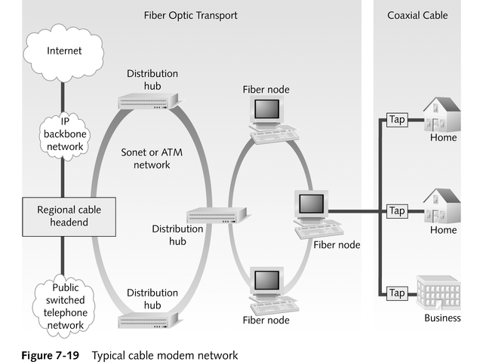
Typical Cable Modem Network

Slide 83
Digital Subscriber Line (DSL)
Uses existing phone lines to carry voice and data simultaneously
Most prominent variety is Asymmetric DSL (ADSL)
Downloads and upload speeds differ significantly
Download speeds from 256 Kbps to 8 Mbps
Upload speeds from 16 Kbps to 640 Kbps
Divides phone line into two frequency ranges, with frequencies below 4 KHz used for voice

Slide 84
Broadcast Technologies
Provides Internet access by satellite television systems
User connects to service provider by regular modem
Service provider, such as DirectTV, sends data to satellite at speeds up to 400 Kbps

Slide 85
Asynchronous Transfer Mode (ATM)
Designed for both LANs and WANs
Uses connection-oriented switches and continuous dedicated circuit between two end systems
Data travels in fixed short 53-byte cells with 5 bytes for header and 48 bytes for data
Enables guaranteed quality of service (QOS)
Choice for long-haul high-bandwidth applications

Slide 86
ATM and SONET Signaling Rates
ATM bandwidth rated in terms of optical carrier level in form OC-x
X represents multiplier of basic OC-1 carrier rate of 51,840 Mbps
Rate originally defined for Synchronous Optical Network (SONET)
Table 7-16 lists common SONET optical carrier rates
Typical ATM rates range from OC-3 to OC-12

Slide 87
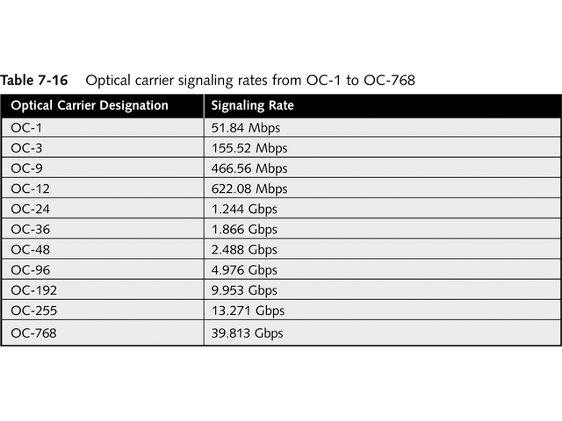
Optical Carrier Signaling Rates

Slide 88
High Performance Parallel Interface (HIPPI)
Originally used with super-computers and high-end workstations
Serial HIPPI is fiber-optic version
Uses series of point-to-point optical links
Provides bandwidth up to 800 Mbps
Commonly used as network backbone prior to advent of Gigabit Ethernet
HIPPI-6400, now known as Gigabyte System Network (GSN), transfers at 6.4 Gbps

Slide 89
Chapter Summary
Architecture defines how data is placed on network, how it is transmitted and at what speed, and how problems in network are handled
Introduced in 1972, Ethernet provides stable method for sending data between computers
Digital, Intel, and Xerox introduced version that became basis for IEEE Ethernet 802.3 standard, which transmits data at 10 Mbps

Slide 90
Chapter Summary
Standard originally defined transmission over thicknet cable (10Base5)
Later revisions used thinnet (10Base2), twisted-pair (10BaseT), and fiber-optic (10BaseF) cables
100 Mbps Ethernet standards have been developed using existing 802.3 standard
Standards use two cable types—twisted-pair and fiber-optic—and two twisted-pair cable configurations

Slide 91
Chapter Summary
Gigabit Ethernet is defined by two standards: 802.3Z and 802.3ab
802.3Z defines 1000BaseX, which is based on Fiber Channel
100BaseX includes 1000BaseLX, 1000BaseSX, and 1000BaseCX, which define Gigabit Ethernet on different media types ranging from single-mode fiber-optic to twin-ax copper cable

Slide 92
Chapter Summary
802.3ab defines 1000BaseT, which is Gigabit Ethernet with Category 5 twisted-pair cable
Emerging technology, 10 Gigabit Ethernet, is underway and specified to run only on fiber-optic cabling
100VG-AnyLAN network technology was developed by AT&T and Hewlett-Packard as an alternate 100 Mbps standard

Slide 93
Chapter Summary
100 VG-AnyLAN uses intelligent hubs and demand priority channel access method
It is attractive alternative mostly because it supports Ethernet and token-ring frames
By using a bridge, any 100 VG-AnyLAN network can easily convert to other network types, including FDDI, token ring, and ATM
100VB-AnyLAN is rarely found in today’s networks due to high implementation cost and dominance of Ethernet

Slide 94
Chapter Summary
Developed by IBM in early 1980s, token ring networks are reliable, fast, and efficient
Token ring can transmit at either 4 Mbps or 16 Mbps
Token ring networks automatically reconfigure themselves to avoid cabling problems
Wired as a physical star, token ring operates as a logical ring

Slide 95
Chapter Summary
One of biggest benefits of token ring is providing all computers equal access to network, enabling the network to grow gracefully
AppleTalk and ARCnet are no longer popular
Macintosh computers use AppleTalk
AppleTalk Phase2 can use Ethernet and token-ring networks to transport AppleTalk
ARCnet is extremely reliable token-passing architecture, but is not very fast

Slide 96
Chapter Summary
ARCnet NICs must be addressed manually, unlike token ring and Ethernet
ARCnet tokens pass through network based on computers’ addresses, not proximity to each other as with token-ring and Ethernet
ARCnet is not as efficient as other available architectures

Slide 97
Chapter Summary
FDDI is very reliable, fast network architecture that uses dual counter-rotating rings in a token-passing environment
Dual rings let FDDI route traffic around problems in network
FDDI is expensive architecture, used where speed and security are paramount
Cable modem technology delivers high-speed Internet access to homes and businesses over existing cable television cable

Slide 98
Chapter Summary
Cable modem provides data rates ranging from 256Kbps to 2.5 Mbps
ATM is high-speed network technology designed both for LANs and WANs
ATM uses connection-oriented switches to permit senders and receivers to communicate
Dedicated circuit between two end systems must be set up before communications begin

Slide 99
Chapter Summary
ATM is best suited for long-haul, high-bandwidth applications
Gigabit Ethernet is still more popular because of ease of incorporation into existing Ethernet networks

